Slide 1

Service Teams User Manual
Access the portal through https://bit.ly/TheNewDataOps
Works best on a PC; limited functionality on mobile.

Slide 2

Click on Service Teams.
There are two options:
Team Heads for service team heads, and
Teams Pastor for pastor-in-charge of service teams.
Select the option that applies to you.
You will be directed to a portal that asks for your login credentials.

Slide 3
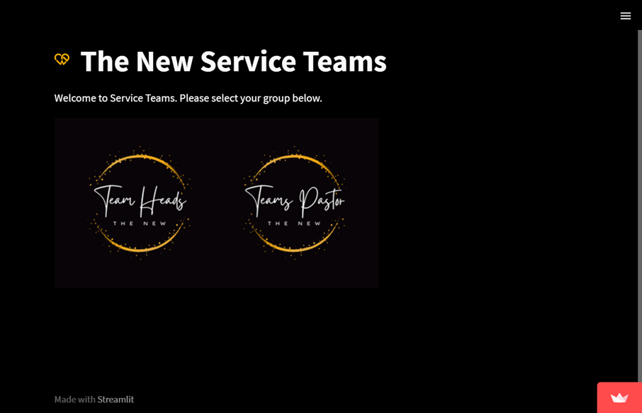
Click on Service Teams.
There are two options:
Team Heads for service team heads, and
Teams Pastor for pastor-in-charge of service teams.
Select the option that applies to you.
You will be directed to a portal that asks for your login credentials.

Slide 4
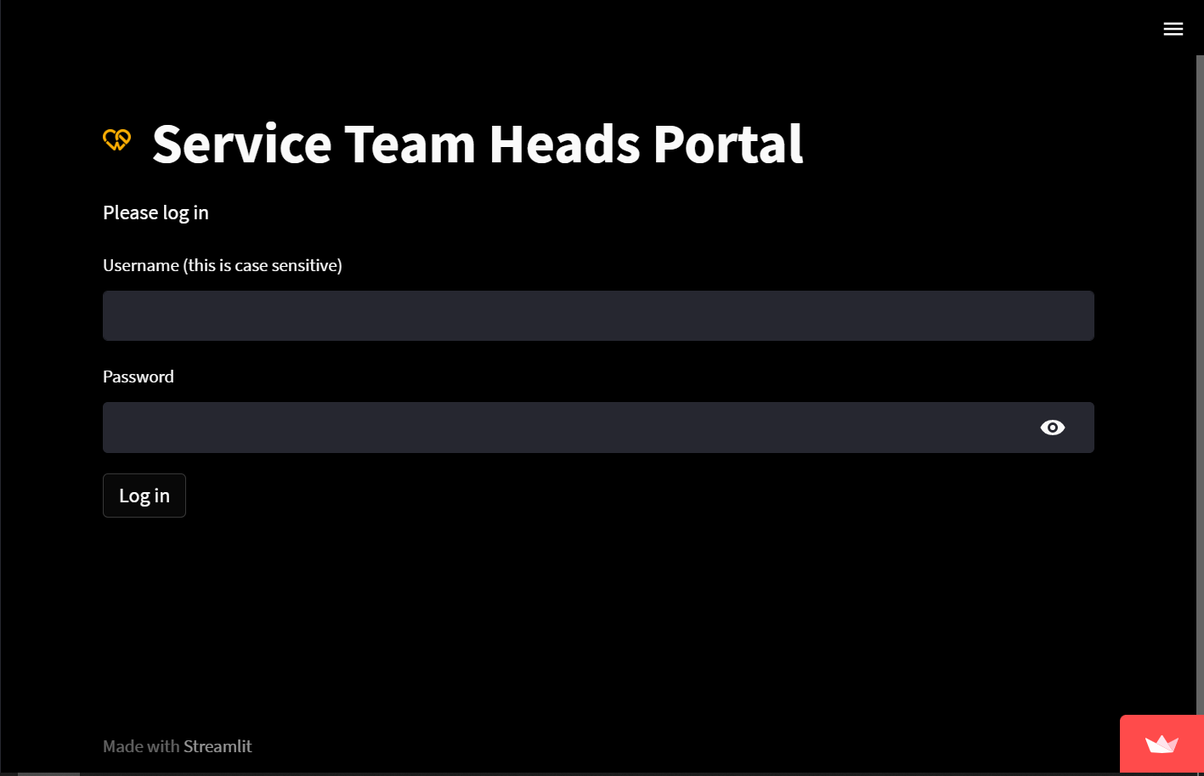
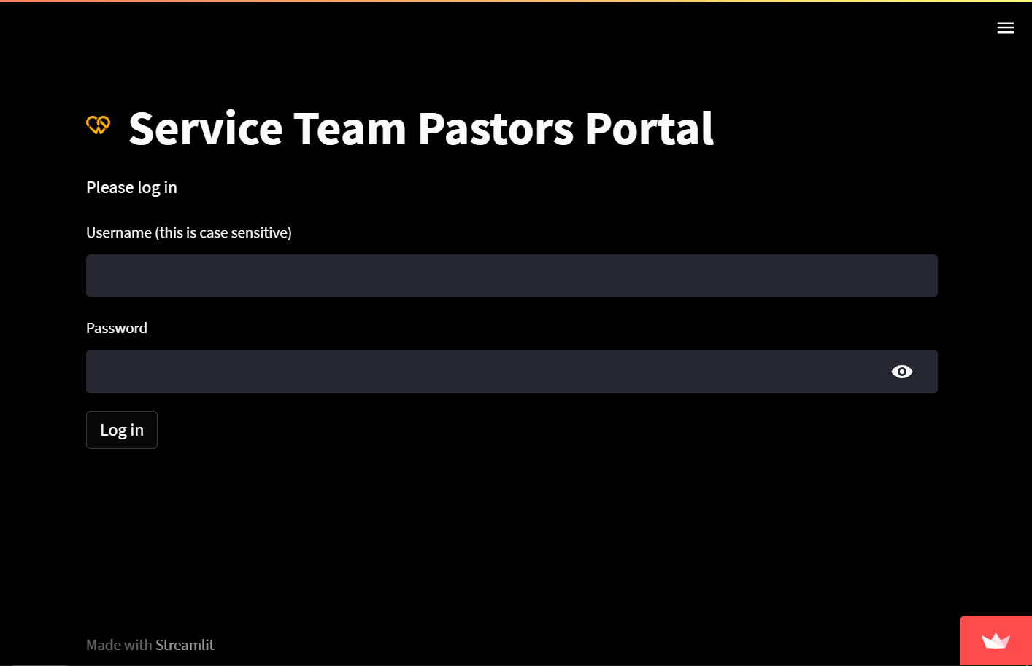
Click on Service Teams.
There are two options:
Team Heads for service team heads, and
Teams Pastor for pastor-in-charge of service teams.
Select the option that applies to you.
You will be directed to a portal that asks for your login credentials.

Slide 5
Service Team Heads

Slide 6
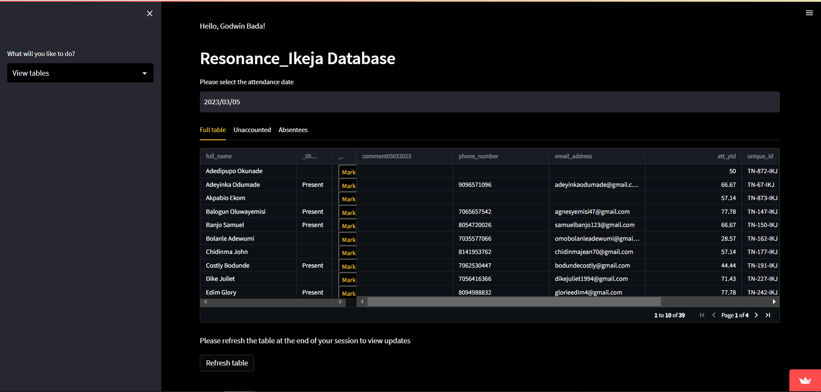
First, select a date that corresponds to a Sunday.
The table with team members data is loaded with a maximum of 10 people per page. You can see more people by clicking the arrow symbols on the table. Comment column is editable for comments; phone number and email address columns are editable for updates
Second, click on the yellow mark button to mark team members as either present, absent or blank (unknown).
Entries are automatically saved, however, click on refresh table after your session to view your updates.
Sidebar Options:
View tables
date
refresh
pages

Slide 7
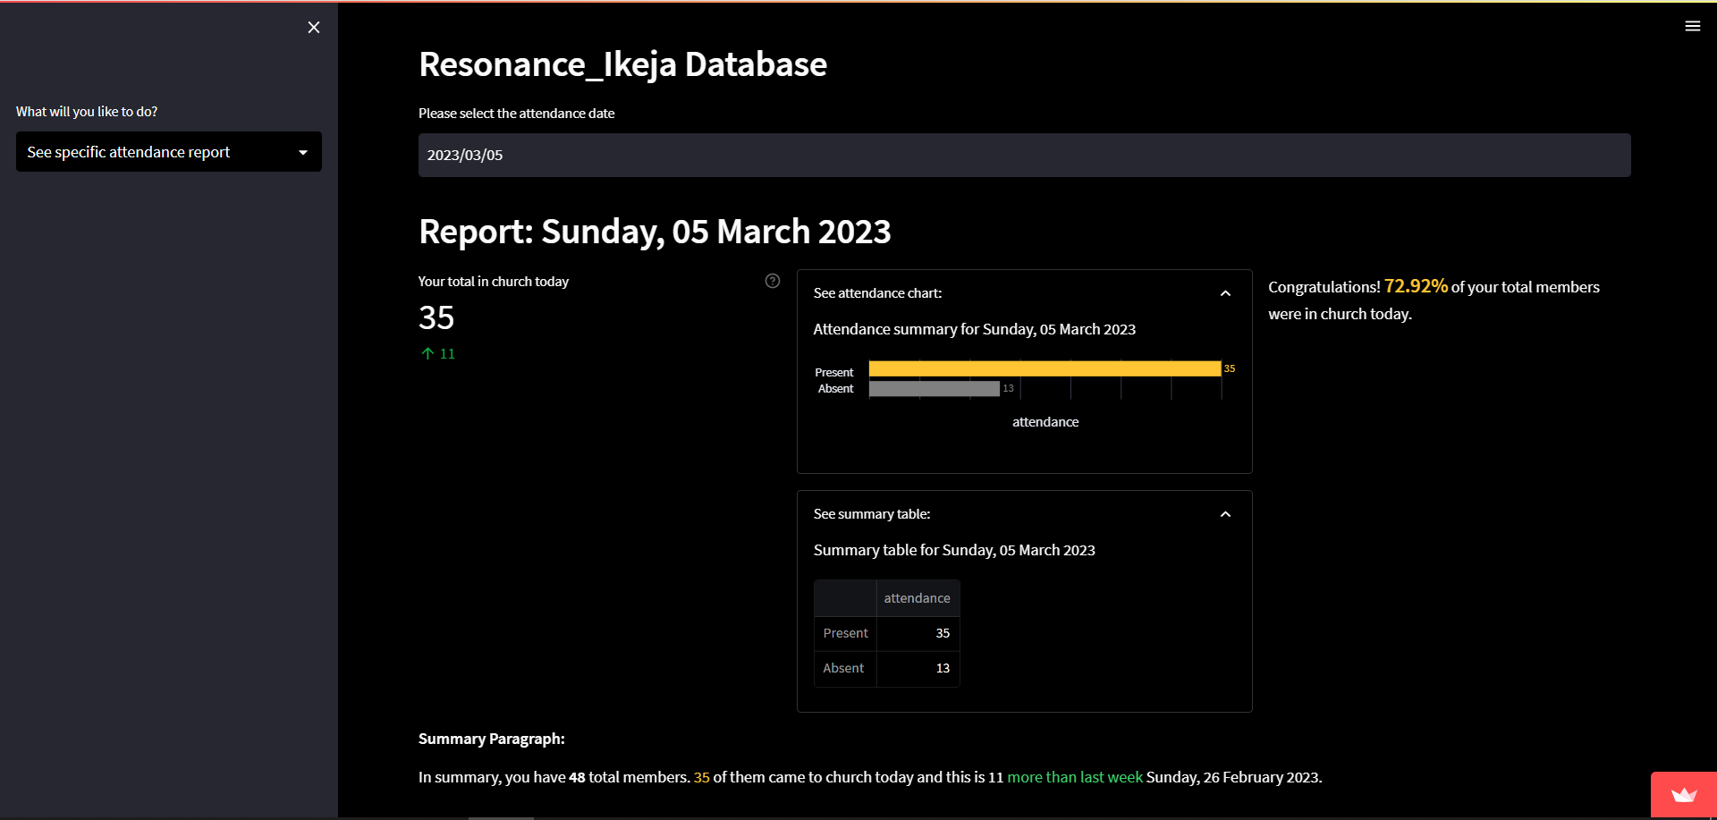
First, select a date that corresponds to a Sunday.
On the left, your total team members in church for the selected Sunday, with a comparison to last week directly underneath (green arrow is an increase; red is a decrease), is shown.
In the middle, the attendance table and chart is shown in an expandable frame with numbers present, absent and blank (unknown).
On the right, the percentage of attendees is shown. A congratulatory message is displayed if more than 70% of your team members are present.
Below is a summary paragraph of the statistics.
Sidebar Options:
Attendance report (best viewed on PC)
Team members in church
Expandable frames
Team attendance percentage

Slide 8
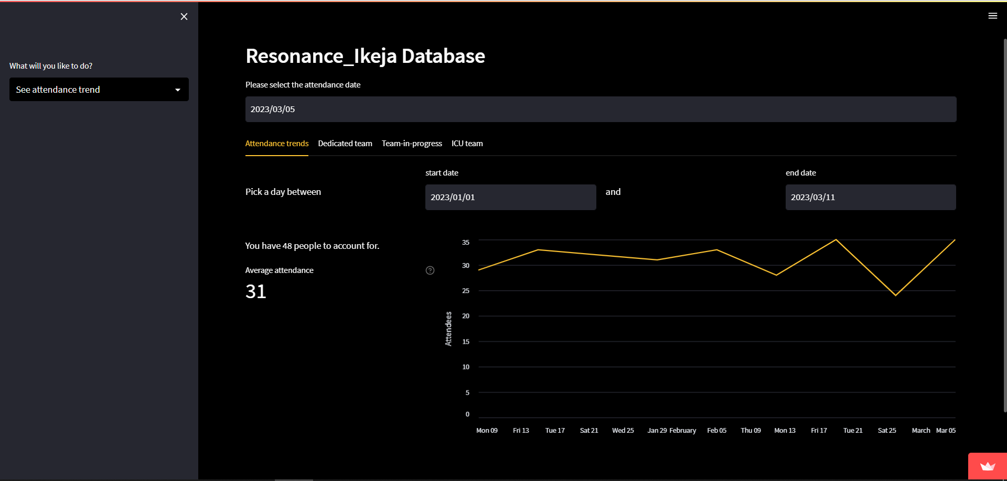
First, select a date that corresponds to a Sunday.
There are four tabs: attendance trends, dedicated team, team-in-progress and ICU team.
Attendance trends show the number of attendees in your team over the selected period. On the left, the average attendance over that period is shown.
Dedicated team lists people in your team with more than 70% attendance each.
Team-in-progress lists people in your team with 50 to 70% attendance each.
ICU team lists people in your team with less than 50% attendance each.
Please pay extra care and attention to your team in progress and ICU team.
Sidebar Options:
Attendance trends (best viewed on PC)
Selected period
Average attendance over selected period

Slide 9
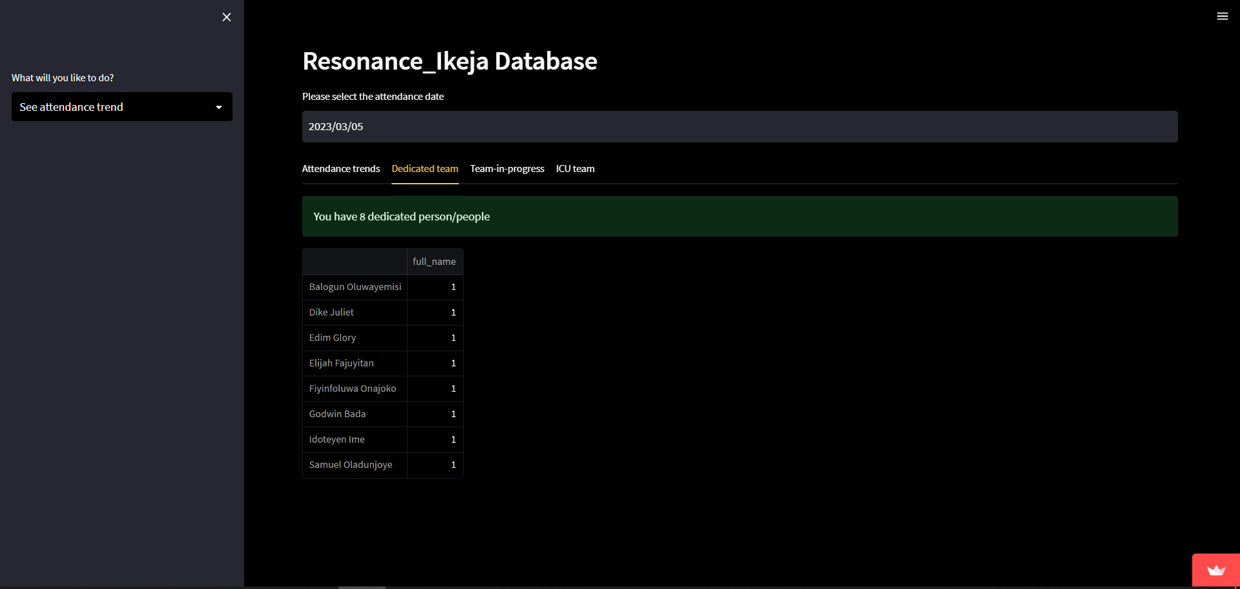
First, select a date that corresponds to a Sunday.
On the left, your total team members in church for the selected Sunday, with a comparison to last week directly underneath (green arrow is an increase; red is a decrease), is shown.
In the middle, the attendance table and chart is shown in an expandable frame with numbers present, absent and blank (unknown).
On the right, the percentage of attendees is shown. A congratulatory message is displayed if more than 70% of your team members are present.
Below is a summary paragraph of the statistics.
Sidebar Options:
Attendance trends (best viewed on PC)

Slide 10
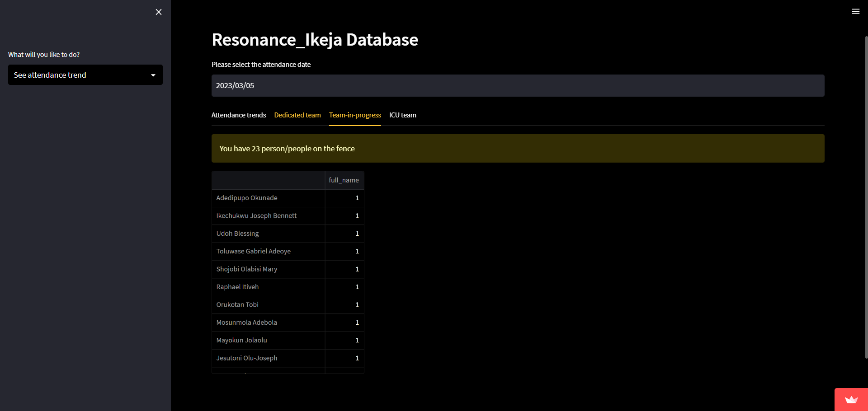
First, select a date that corresponds to a Sunday.
On the left, your total team members in church for the selected Sunday, with a comparison to last week directly underneath (green arrow is an increase; red is a decrease), is shown.
In the middle, the attendance table and chart is shown in an expandable frame with numbers present, absent and blank (unknown).
On the right, the percentage of attendees is shown. A congratulatory message is displayed if more than 70% of your team members are present.
Below is a summary paragraph of the statistics.
Sidebar Options:
Attendance trends (best viewed on PC)

Slide 11
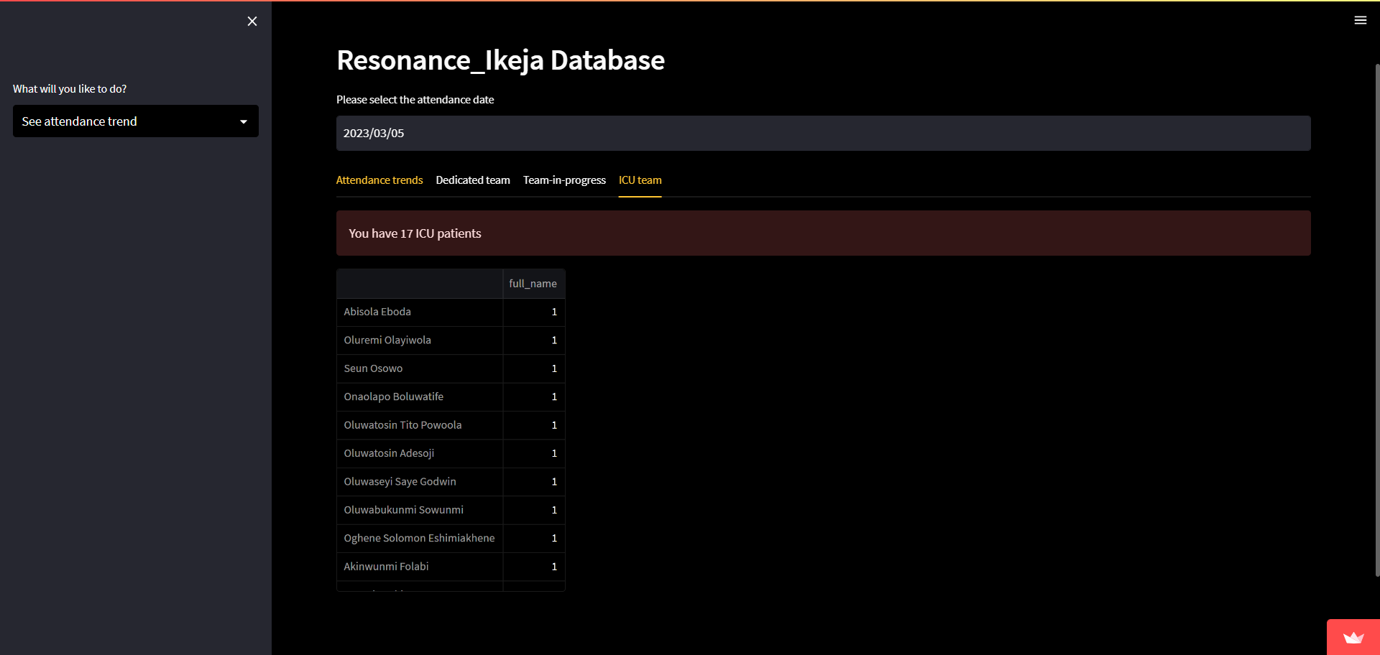
First, select a date that corresponds to a Sunday.
On the left, your total team members in church for the selected Sunday, with a comparison to last week directly underneath (green arrow is an increase; red is a decrease), is shown.
In the middle, the attendance table and chart is shown in an expandable frame with numbers present, absent and blank (unknown).
On the right, the percentage of attendees is shown. A congratulatory message is displayed if more than 70% of your team members are present.
Below is a summary paragraph of the statistics.
Sidebar Options:
Attendance trends (best viewed on PC)

Slide 12
Pastor-in-charge (Service Teams)

Slide 13
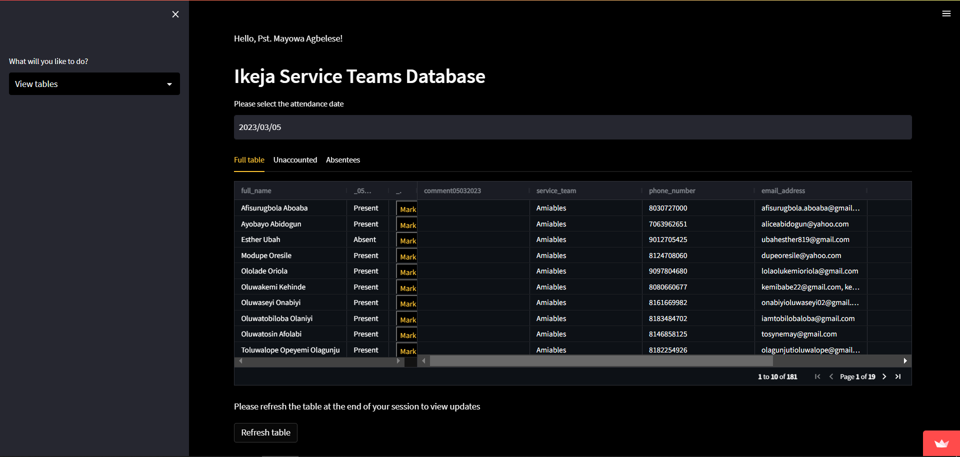
First, select a date that corresponds to a Sunday.
The table with all service team members data is loaded with a maximum of 10 people per page. You can see more people by clicking the arrow symbols on the table. Comments, phone number, and email address columns are editable for updates.
Second, click on the yellow mark button to mark team members as either present, absent or blank (unknown). Alternatively, you can alert the service team head.
Entries are automatically saved, however, click on refresh table after your session to view your updates.
Sidebar Options:
View tables
date
refresh
pages

Slide 14
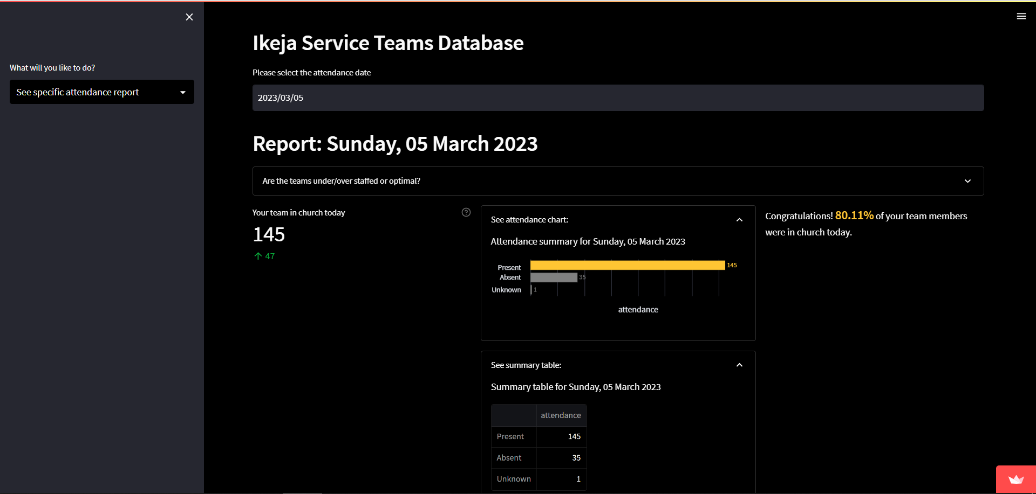
First, select a date that corresponds to a Sunday.
On the left, your total team members in church for the selected Sunday, with a comparison to last week directly underneath (green arrow is an increase; red is a decrease), is shown.
In the middle, the attendance table and chart is shown in an expandable frame with numbers present, absent and blank (unknown).
On the right, the percentage of attendees is shown. A congratulatory message is displayed if more than 70% of your team members are present.
Sidebar Options:
Attendance report (best viewed on PC)
Team members in church
Expandable frames
Team attendance percentage

Slide 15
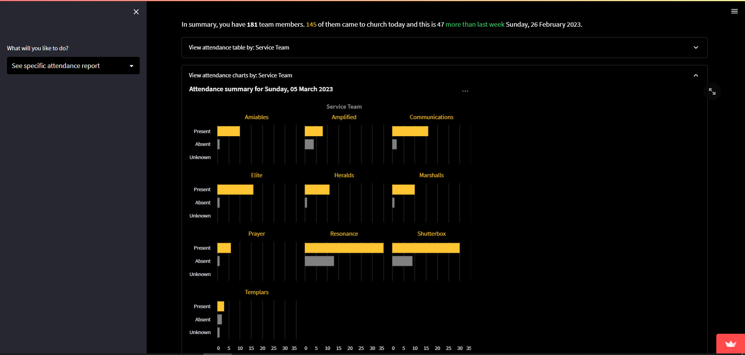
First, select a date that corresponds to a Sunday.
Below is a summary paragraph.
There are also expandable frames that shows you attendance per service team either as tables or charts.
Please alert service team heads where necessary e.g., if most of their team members are still unaccounted for.
Sidebar Options:
Attendance report (best viewed on PC)

Slide 16
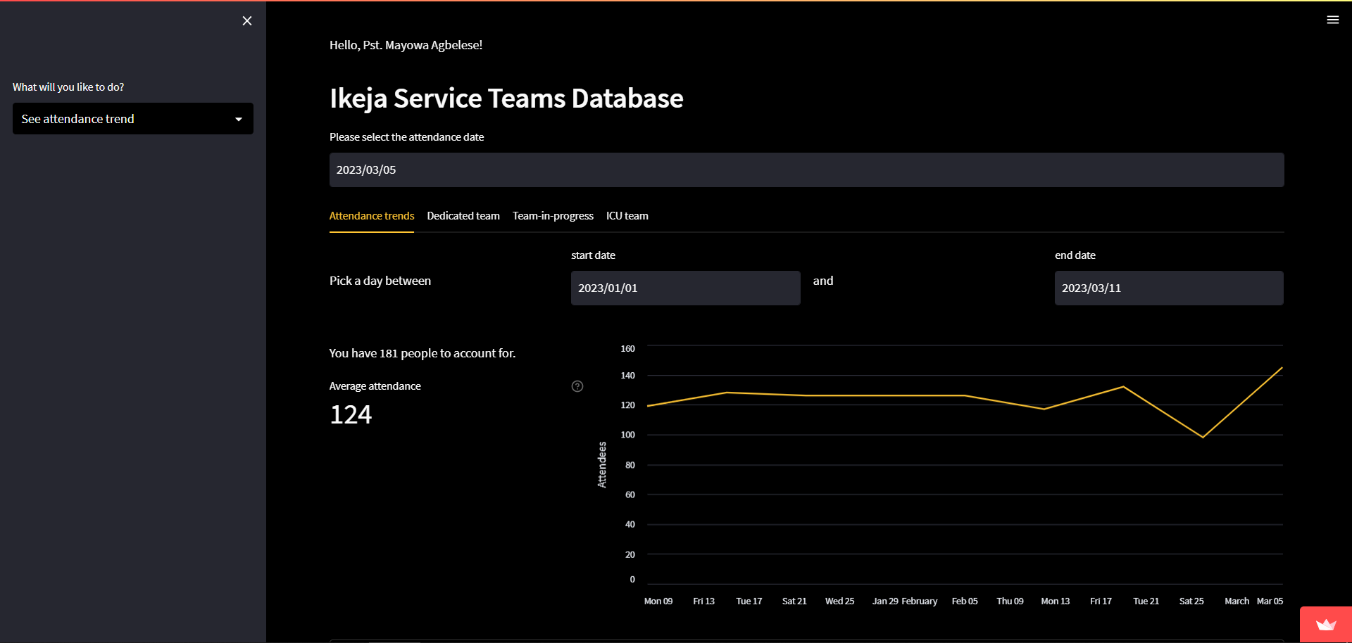
First, select a date that corresponds to a Sunday.
There are four tabs: attendance trends, dedicated team, team-in-progress and ICU team.
Attendance trends show the number of attendees in your team over the selected period. On the left, the average attendance over that period is shown. There is also an expandable frame that shows attendance trends per service team.
Dedicated team counts people in each service team with more than 70% attendance each.
Team-in-progress counts people in each service team with 50 to 70% attendance each.
ICU team counts people in each service team with less than 50% attendance each.
Please pay extra care and attention to your team in progress and ICU team.
Sidebar Options:
Attendance trends (best viewed on PC)
Selected period
Average attendance over selected period

Slide 17
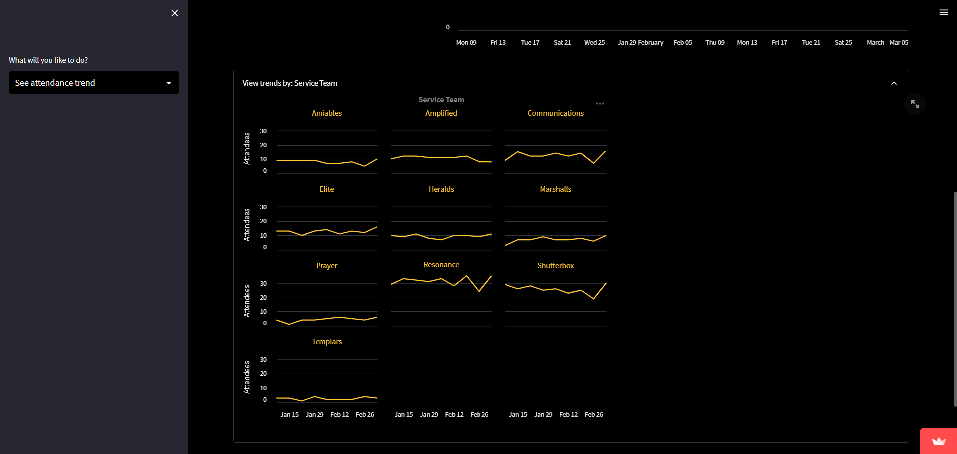
First, select a date that corresponds to a Sunday.
There are four tabs: attendance trends, dedicated team, team-in-progress and ICU team.
Attendance trends show the number of attendees in your team over the selected period. On the left, the average attendance over that period is shown. There is also an expandable frame that shows attendance trends per service team.
Dedicated team counts people in each service team with more than 70% attendance each.
Team-in-progress counts people in each service team with 50 to 70% attendance each.
ICU team counts people in each service team with less than 50% attendance each.
Please pay extra care and attention to your team in progress and ICU team.
Sidebar Options:
Attendance trends (best viewed on PC)

Slide 18
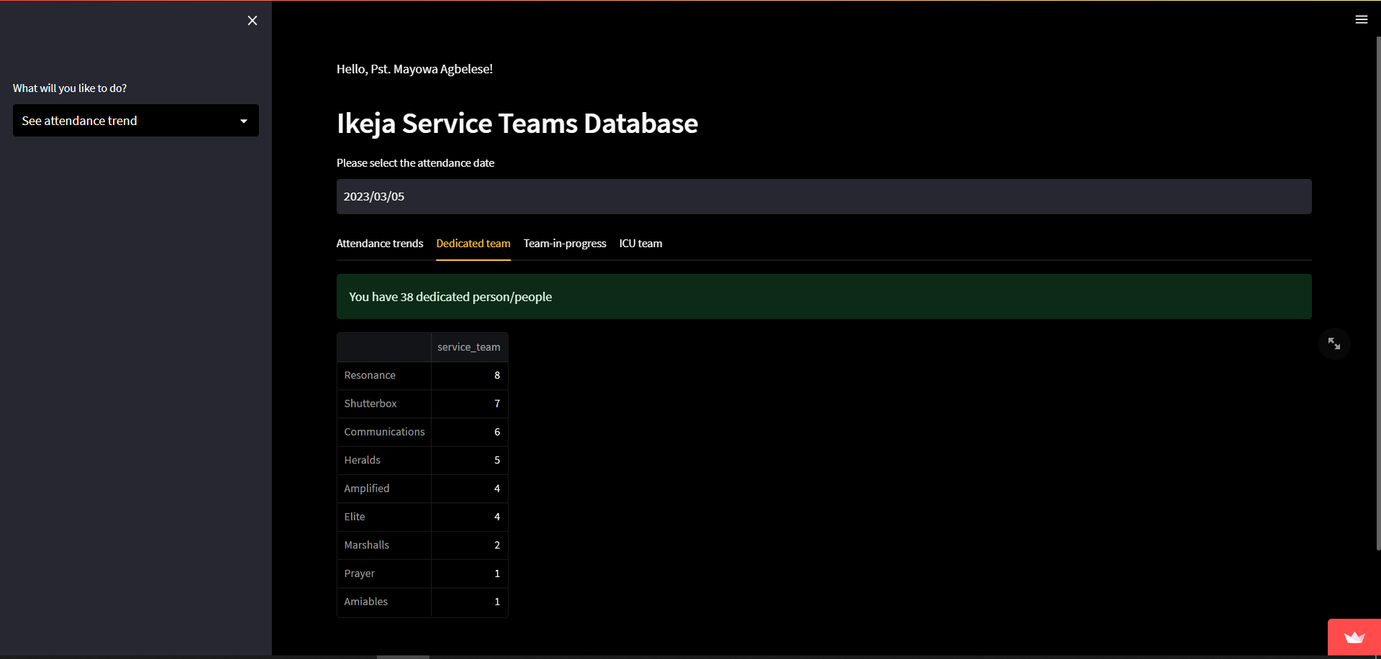
First, select a date that corresponds to a Sunday.
There are four tabs: attendance trends, dedicated team, team-in-progress and ICU team.
Attendance trends show the number of attendees in your team over the selected period. On the left, the average attendance over that period is shown. There is also an expandable frame that shows attendance trends per service team.
Dedicated team counts people in each service team with more than 70% attendance each.
Team-in-progress counts people in each service team with 50 to 70% attendance each.
ICU team counts people in each service team with less than 50% attendance each.
Please pay extra care and attention to your team in progress and ICU team.
Sidebar Options:
Attendance trends (best viewed on PC)

Slide 19
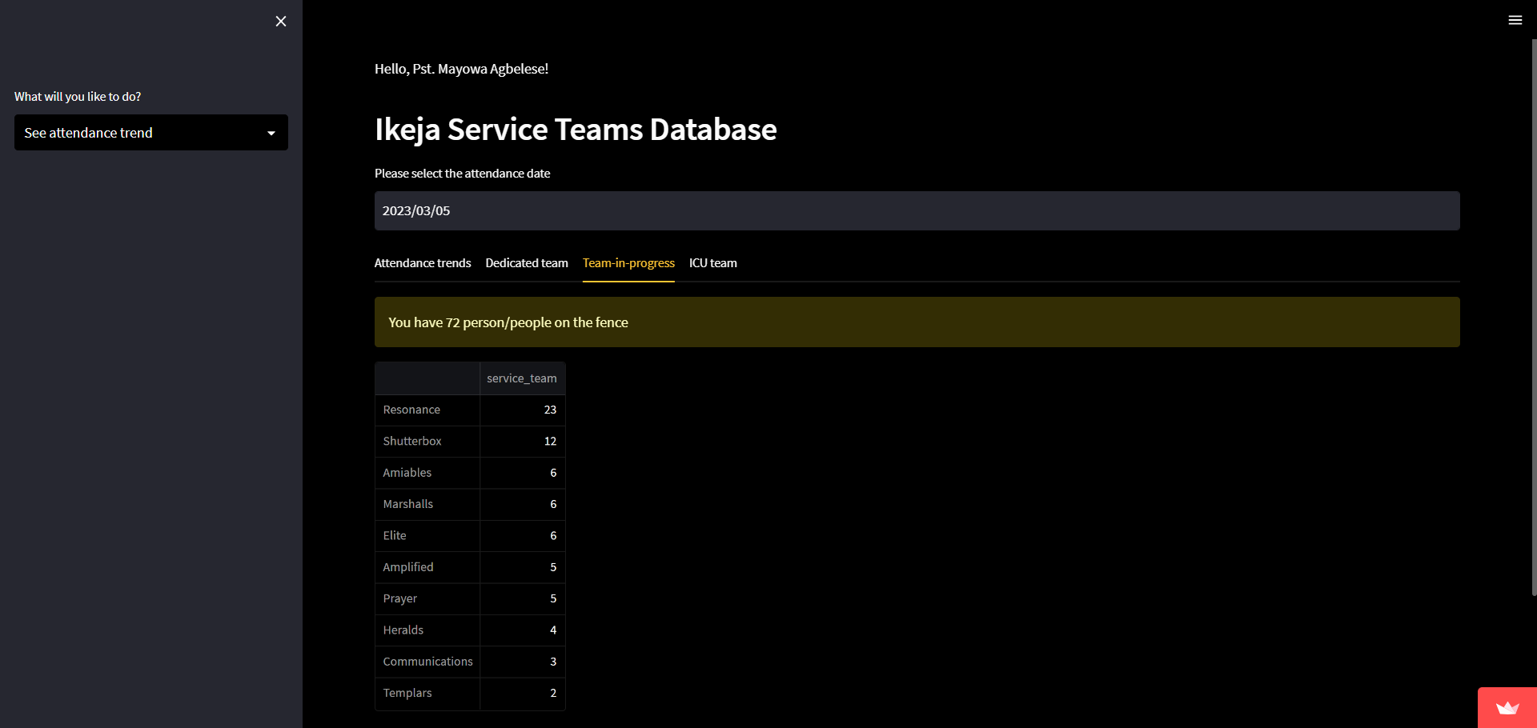
First, select a date that corresponds to a Sunday.
There are four tabs: attendance trends, dedicated team, team-in-progress and ICU team.
Attendance trends show the number of attendees in your team over the selected period. On the left, the average attendance over that period is shown. There is also an expandable frame that shows attendance trends per service team.
Dedicated team counts people in each service team with more than 70% attendance each.
Team-in-progress counts people in each service team with 50 to 70% attendance each.
ICU team counts people in each service team with less than 50% attendance each.
Please pay extra care and attention to your team in progress and ICU team.
Sidebar Options:
Attendance trends (best viewed on PC)

Slide 20
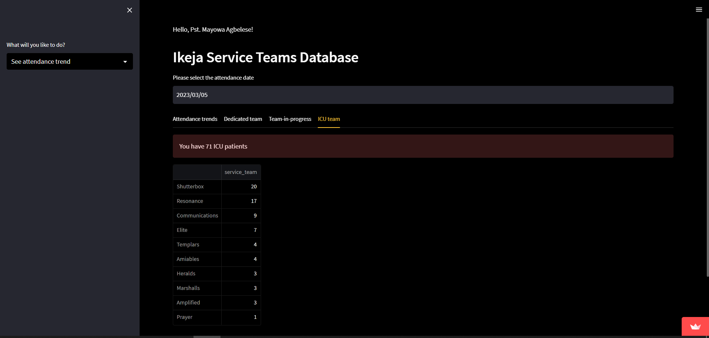
First, select a date that corresponds to a Sunday.
There are four tabs: attendance trends, dedicated team, team-in-progress and ICU team.
Attendance trends show the number of attendees in your team over the selected period. On the left, the average attendance over that period is shown. There is also an expandable frame that shows attendance trends per service team.
Dedicated team counts people in each service team with more than 70% attendance each.
Team-in-progress counts people in each service team with 50 to 70% attendance each.
ICU team counts people in each service team with less than 50% attendance each.
Please pay extra care and attention to your team in progress and ICU team.
Sidebar Options:
Attendance trends (best viewed on PC)

Slide 21
Login Credentials

Slide 22
Universal Password is: untilmyjobisdone
Username | Service Team
Tomiwa | ServiceTeamsPastor Ife
Ayotide | Amplified Ife
Gbemisola | Elite Ife
Gladys | Resonance Ife
Kome | Heralds Ife
Opeyemi | Shutterbox Ife
Tolu | Amiables Ife

Slide 23
Thank You

